Slide 1
Java Enterprise Development
Course “Spring – first touch”
Section 1

Slide 2
Agenda
Application Layers
Frameworks and Technologies
Application problems
Possible Solution

Slide 3
Application Layers
Frameworks and Technologies

Slide 4
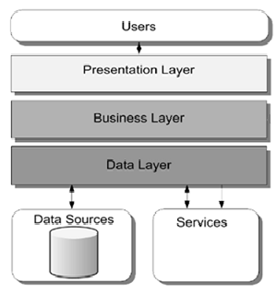
Application layers

Slide 5







Presentation Layer

Slide 6




Business Layer

Slide 7





Data Layer

Slide 8




Integration Layer

Slide 9
Application problems

Slide 10
Three problems
Application size
Integration
Configuration

Slide 11
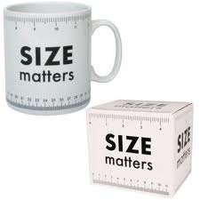
Application size problem

Slide 12
Application size
Typical web app size:
1000 – 10000 classes
SRCIS
  Server – 1800 classes
  UI - 1200 classes

Slide 13

Integration problem

Slide 14
How to
integrate all technologies:
  JSP/Servlet, Web Services, Dozer, GWT, Hibernate, JDBC, Log4j, JavaMail API, Quartz, Apache POI, EJB, Slf4j, Java Transaction API, etc.
to one application?

Slide 15

Configuration problem

Slide 16
How to
configure all technologies:
  JSP/Servlet, Web Services, Dozer, GWT, Hibernate, JDBC, Log4j, JavaMail API, Quartz, Apache POI, EJB, Slf4j, Java Transaction API, etc.
inside one application?

Slide 17
Possible Solution

Slide 18
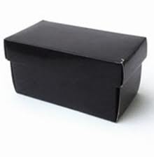
We need Black Box

Slide 19
Put all things inside
JSP/Servlet, Web Services, Dozer, GWT, Hibernate, JDBC, Log4j, JavaMail API, Quartz, Apache POI, EJB, Slf4j, Java Transaction API

Slide 20
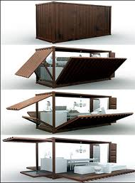
Get all goods ready to use

Slide 21

Solution

Slide 22

Any Questions?

Slide 23
References
http://martinfowler.com/books.html
http://www.softwarearchitecturebook.com/
http://www.bredemeyer.com/papers.htm

